Slide 1
Rental System
Submitted By:
Amar Mahato (THA081BCT002)
Birendra Giri (TH081BCT005)
Bishrut Kafle (THA081BCT006)
Karun Lamsal (THA081BCT013)
Submitted To:
Department of Electronics and Computer Engineering
Thapathali Campus
Kathmandu, Nepal
12th March,2025

Slide 2
Introduction
A program that lets users rent goods
Has stockpile of wide range of goods
Reduces human error in stock management and billings
Generates transaction bills and log all rental/return operations
Implements dynamic memory management for handling inventory

Slide 3
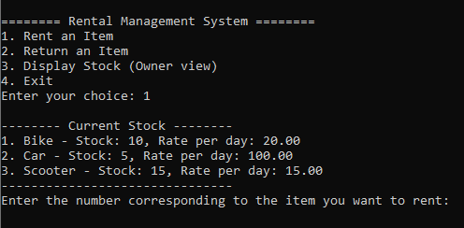
Project Preview
Home Page
Asks user to rent/return an item
Shows the items in warehouse available to rent

Slide 4
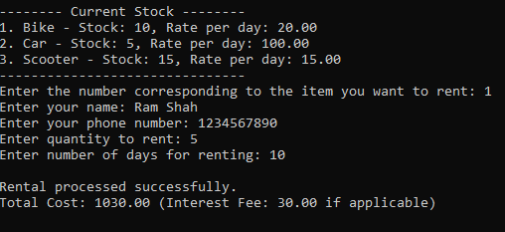
Cont'd
Renting Process
Asks the user's details i.e. name and phone no.
Asks the quantity and duration of renting
Calculates the total cost of rent

Slide 5
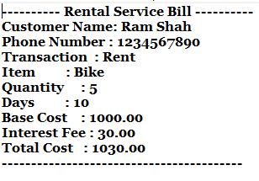
Cont'd
Billing Process
Displays the user's details
Calculates the total cost and displays it
Adds 1% interest if duration of rent exceeds 7 days

Slide 6
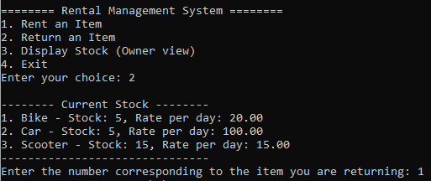
Cont'd
Returning Process
Displays the items available in stock
Asks the user for the item to return

Slide 7
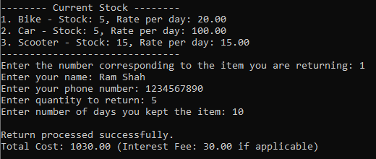
Cont'd
Returning Process
Asks the user's details and items to be returned
Updates the stock available in warehouse

Slide 8
Scope and Applications
Program can be easily extended
Usable by people of all age group
Allows easier circulation of goods in warehouse
No place for error as all calculations are computed digitally
Penalty interest ensures consumers return goods in given time period

Slide 9


